Slide 1
Academic Dashboard

Slide 2
What is Academic Dashboard?
Authentication & Authorization: Secure access, user privacy, seamless logout
Performance Analysis: Student comparison, improvement tracking
Digital Course Dashboard: Visual course structure, flexible curriculum management
Student Performance Table: Comprehensive student view, performance monitoring.
Reminders & Communication: One-click reminders, customized communication

Slide 3
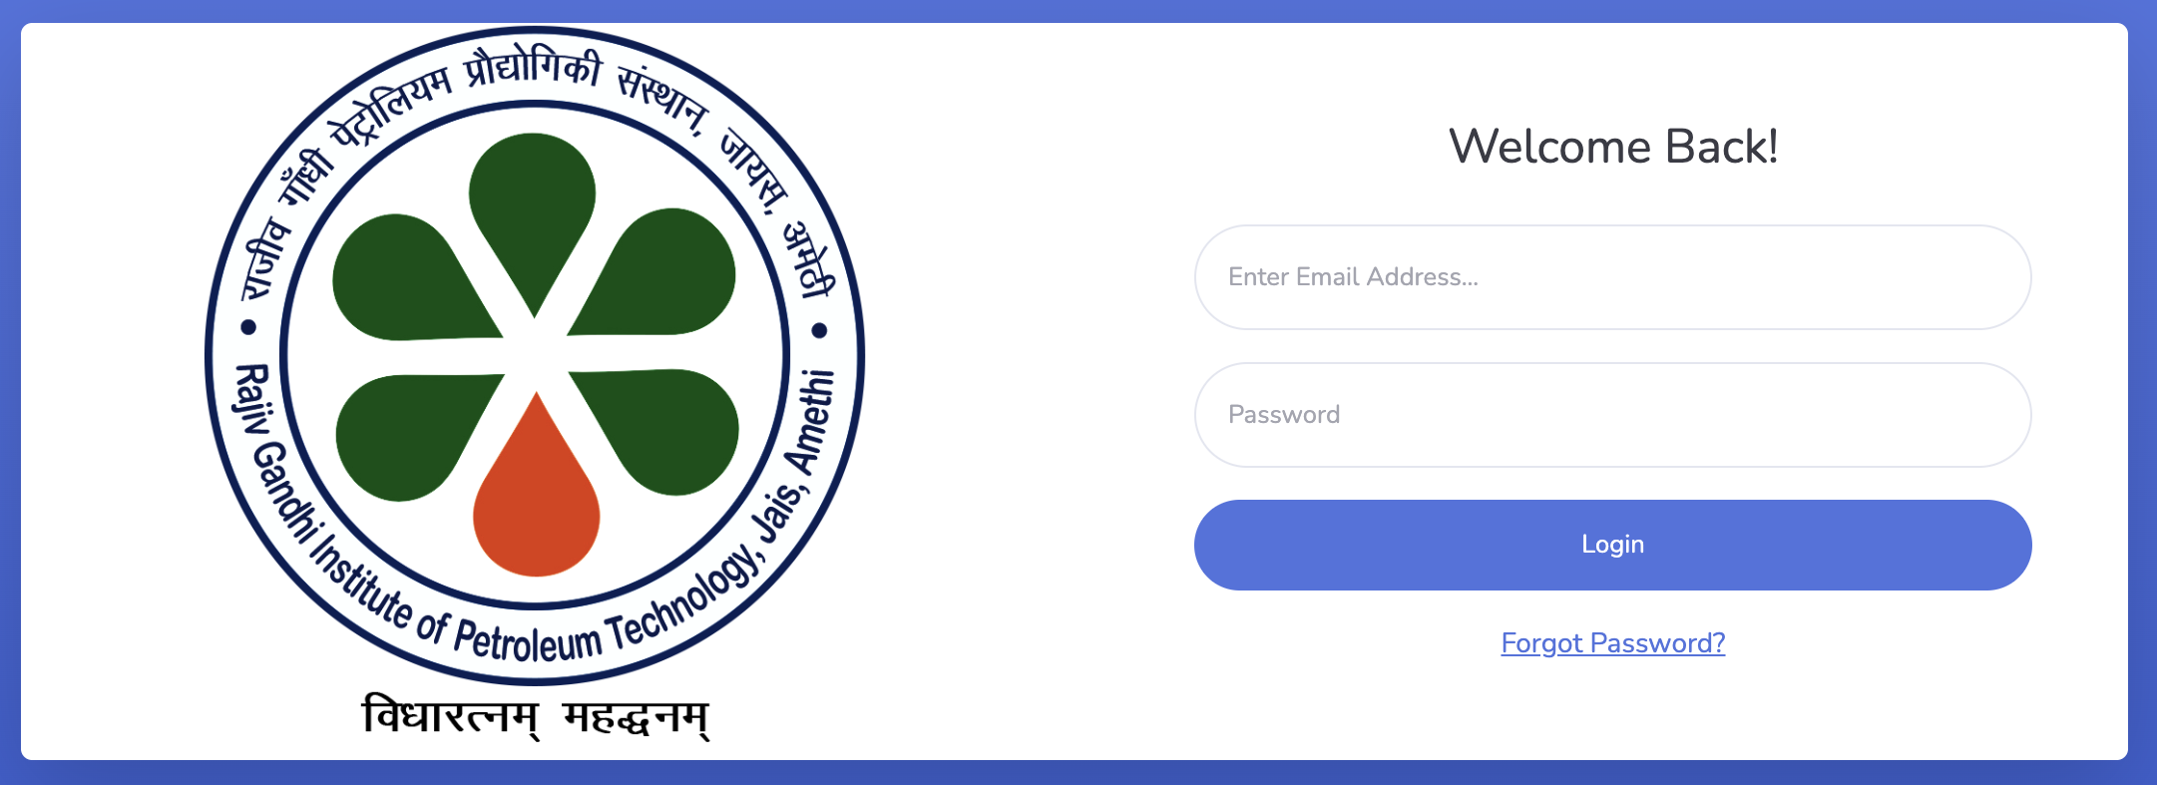
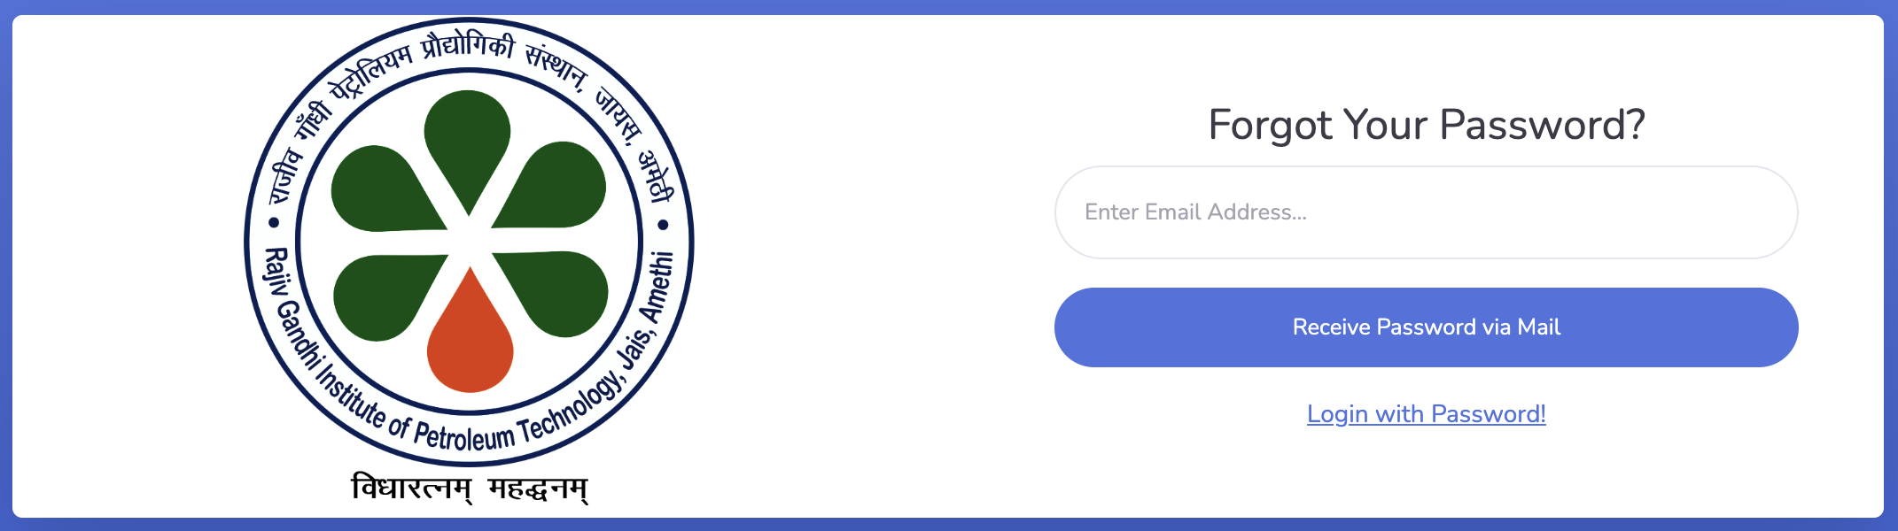
Login and Forget Password

Slide 4
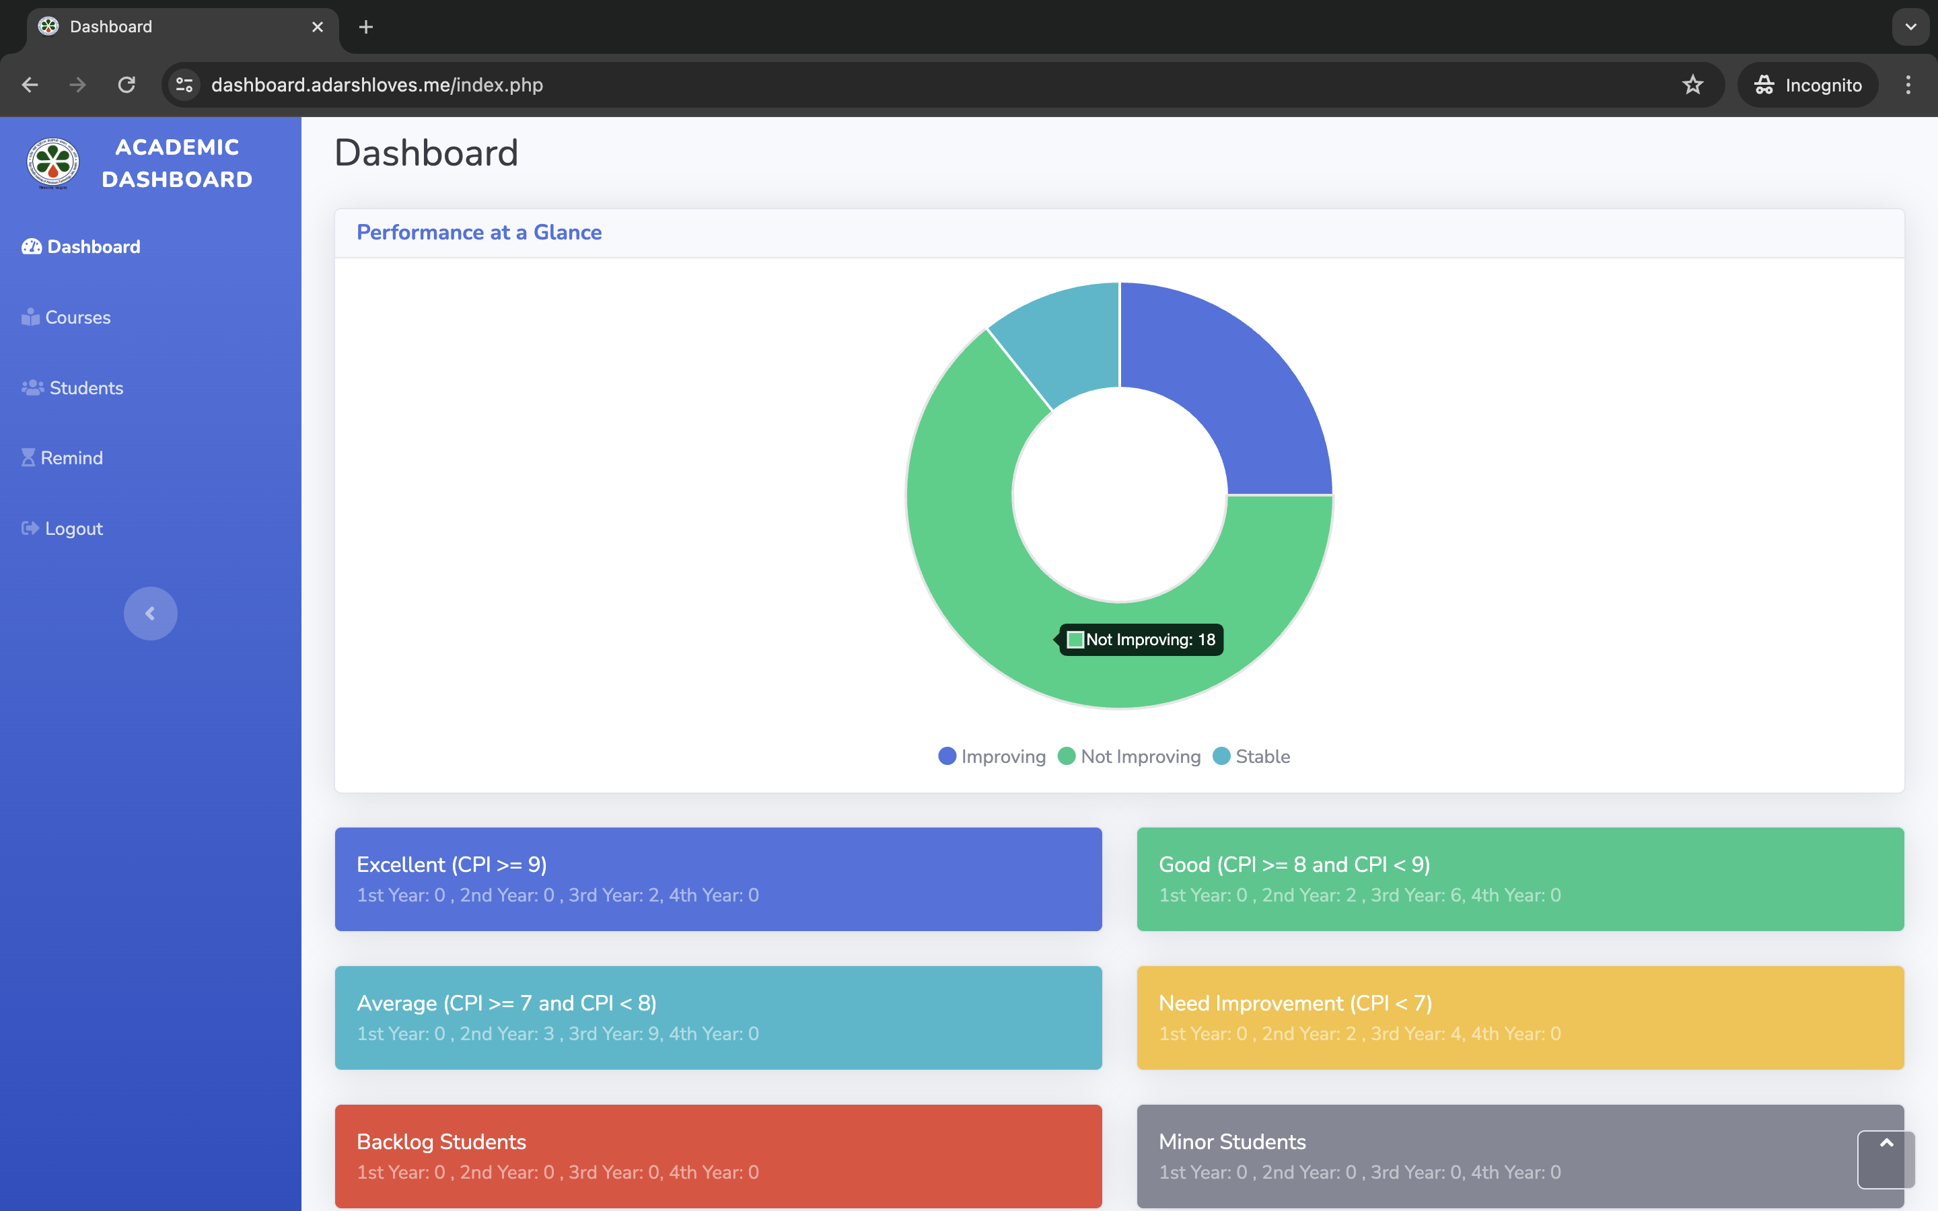
Dashboard

Slide 5
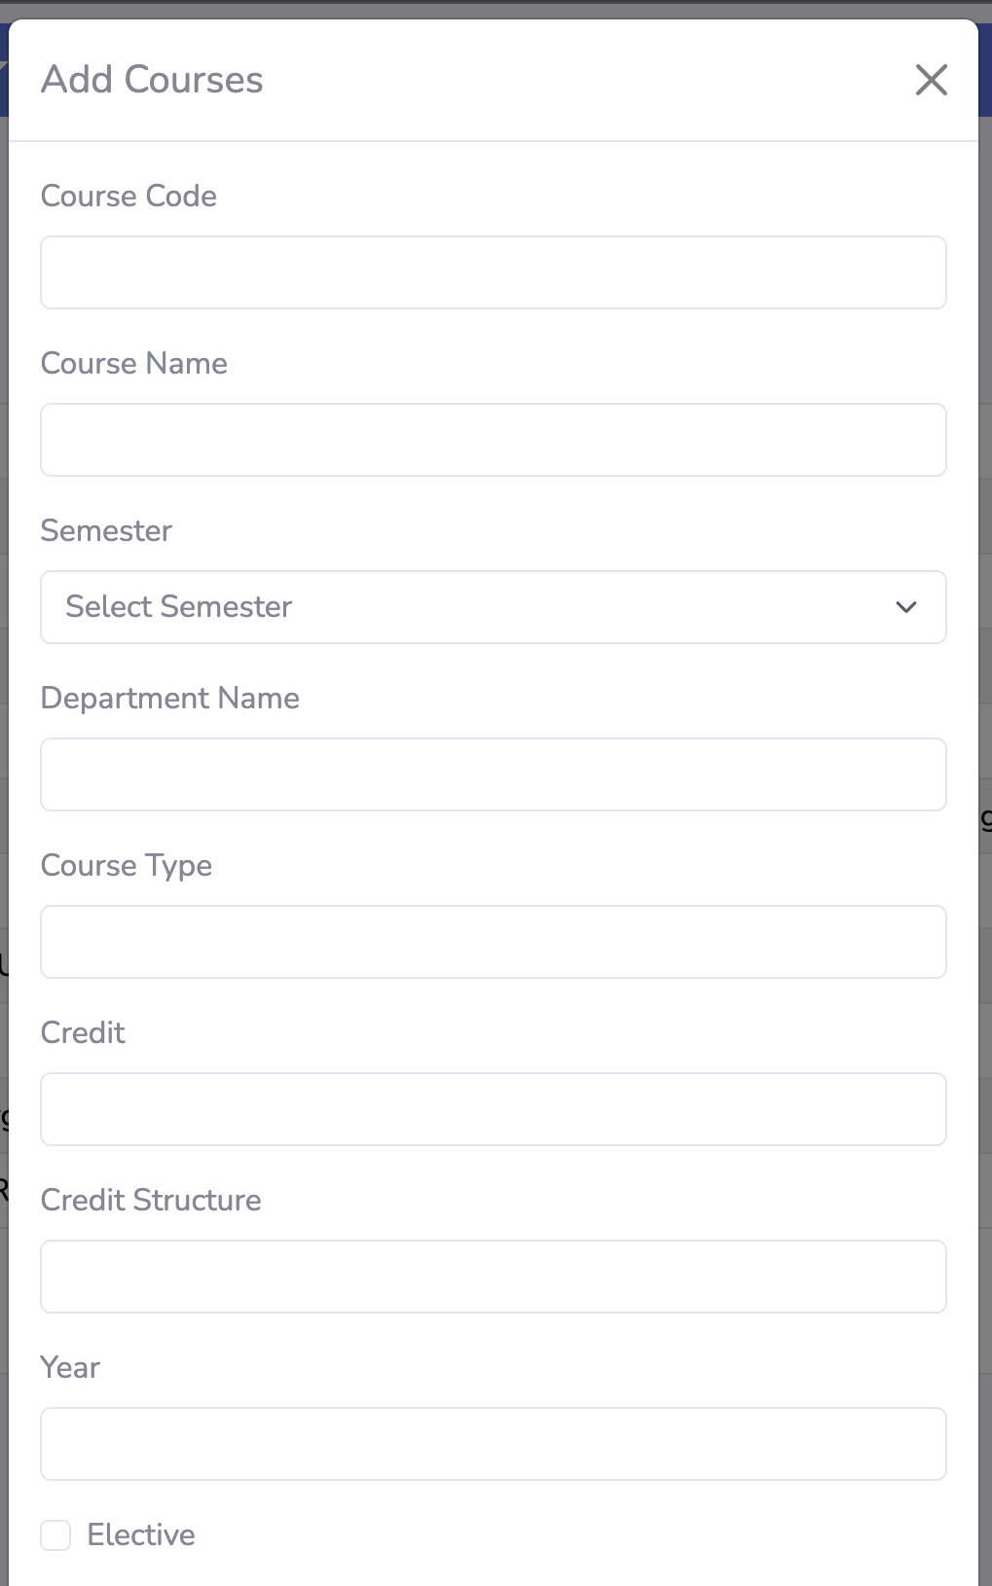
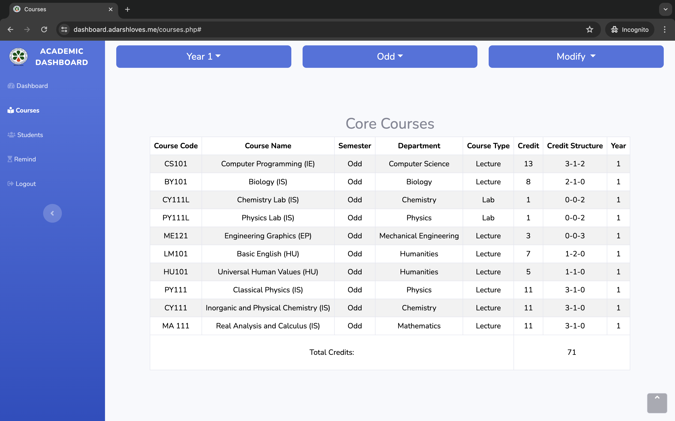
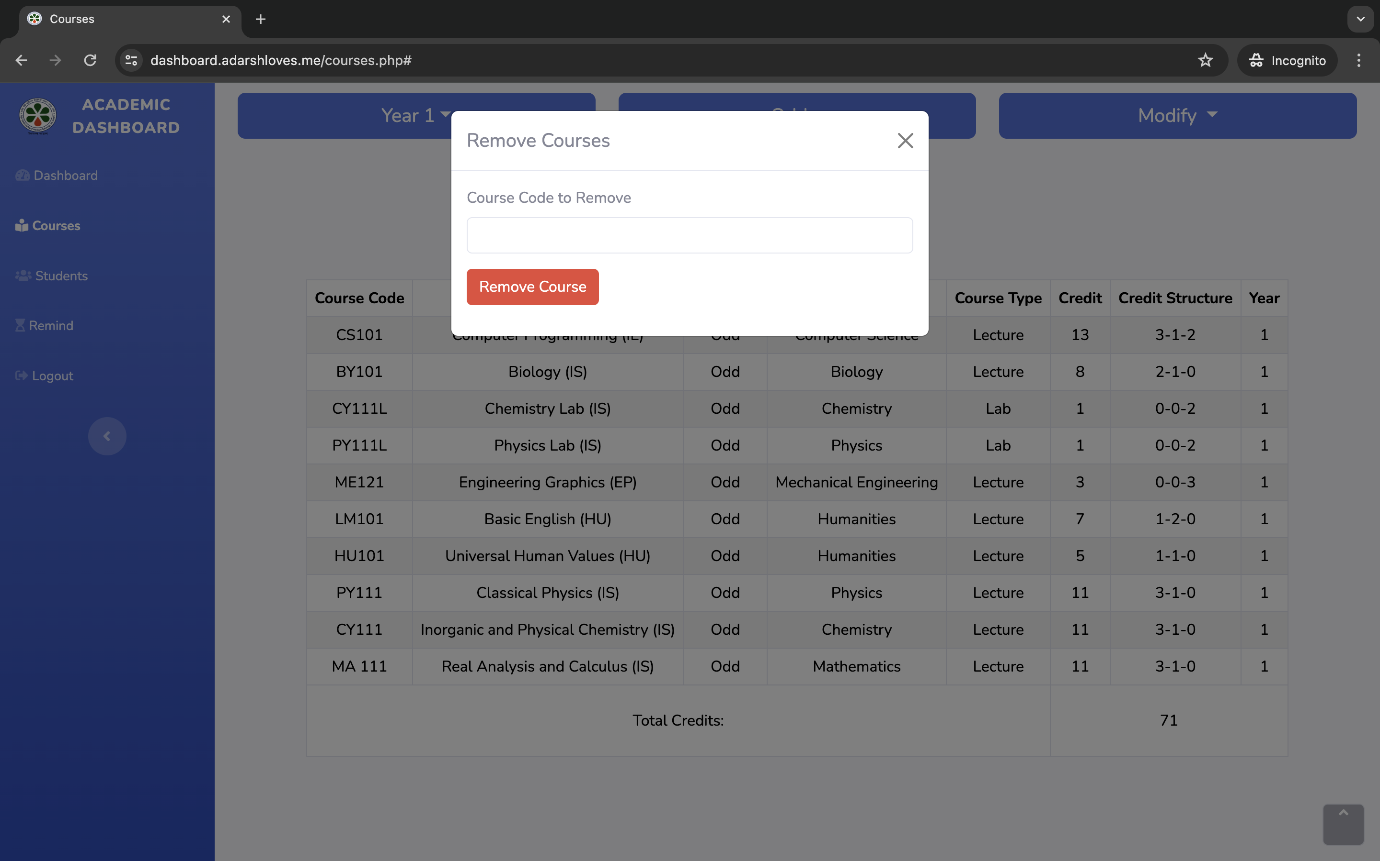

Courses

Slide 6
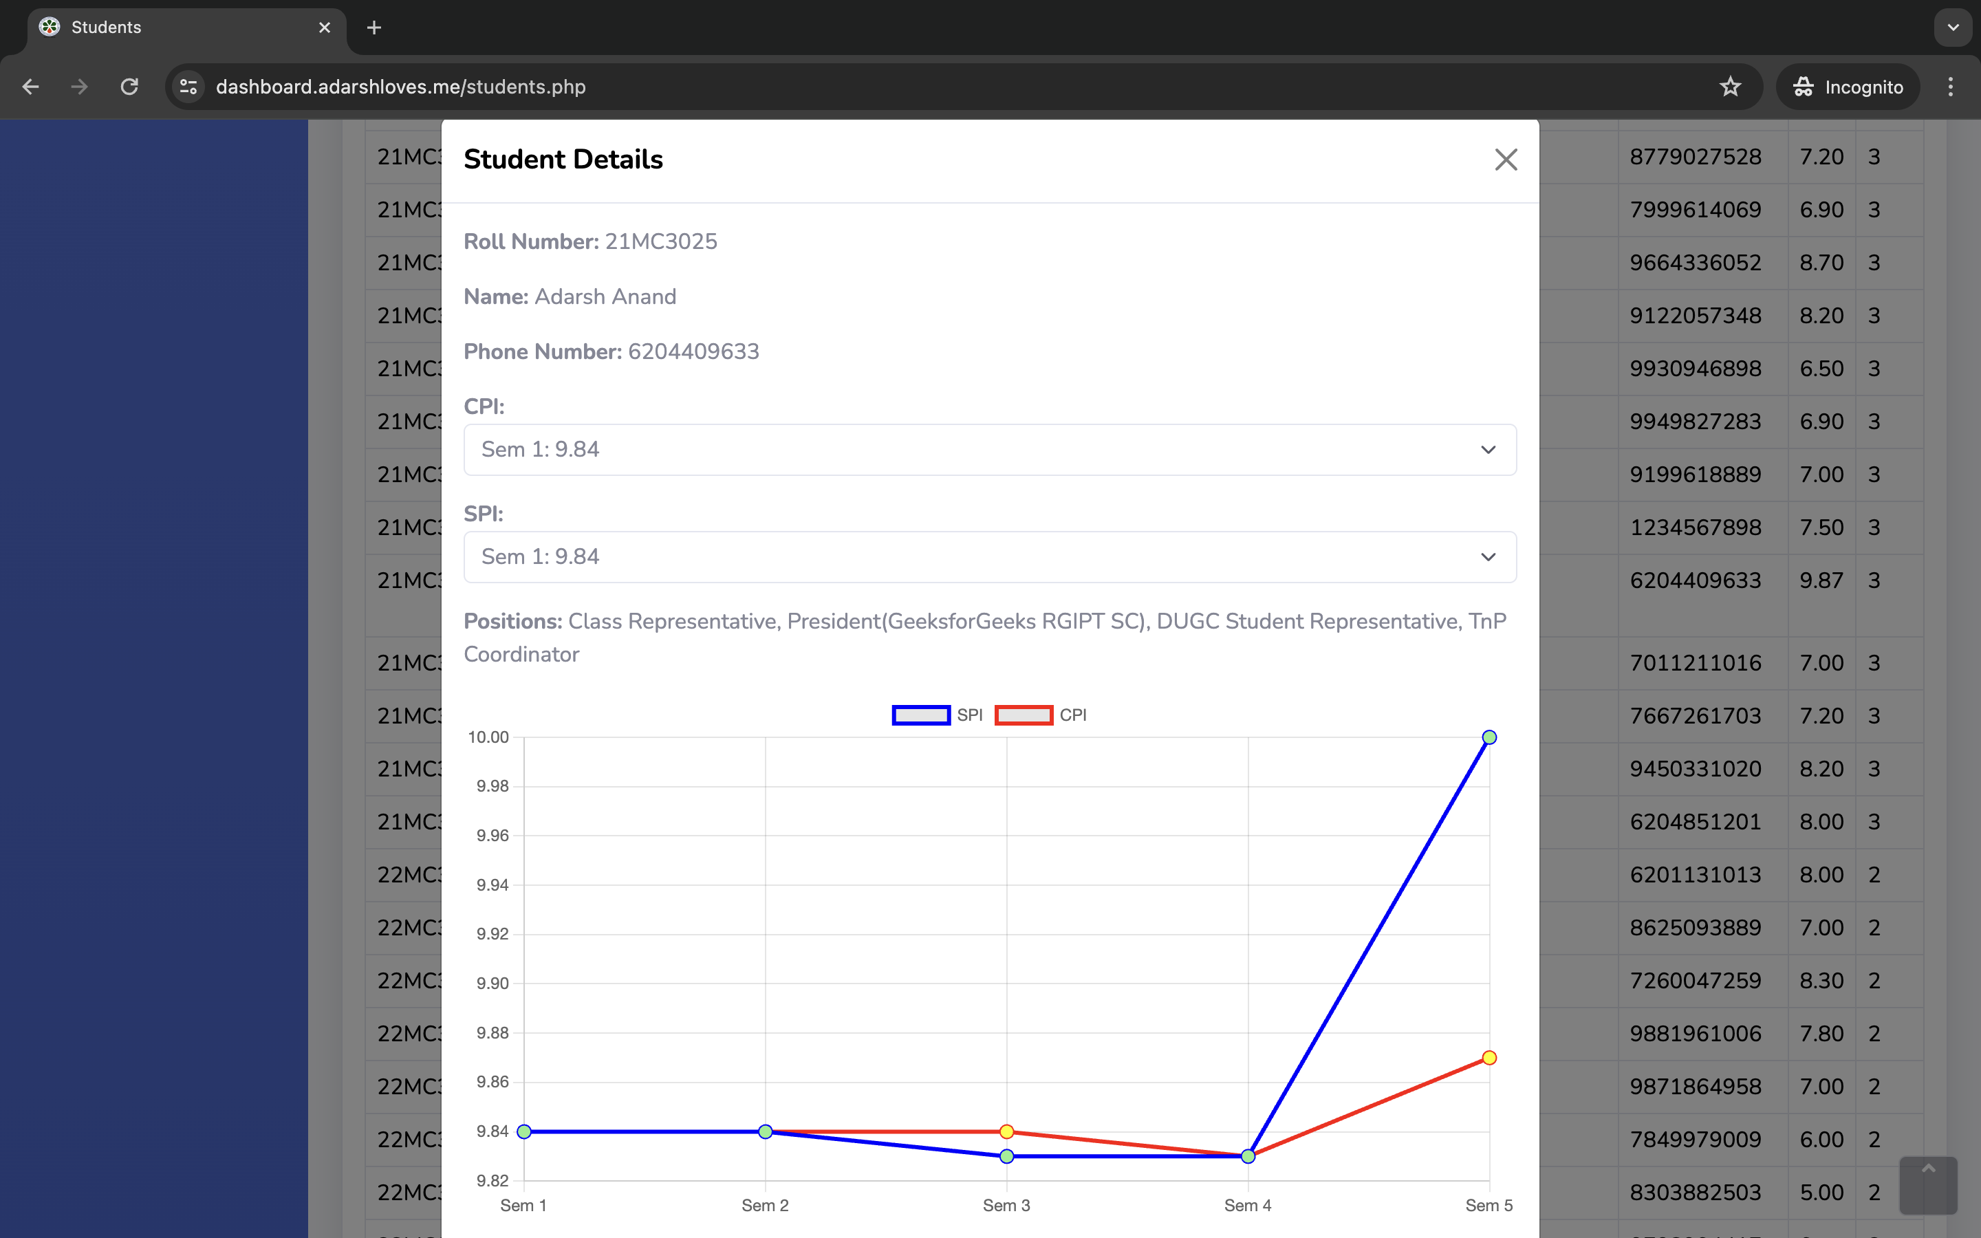
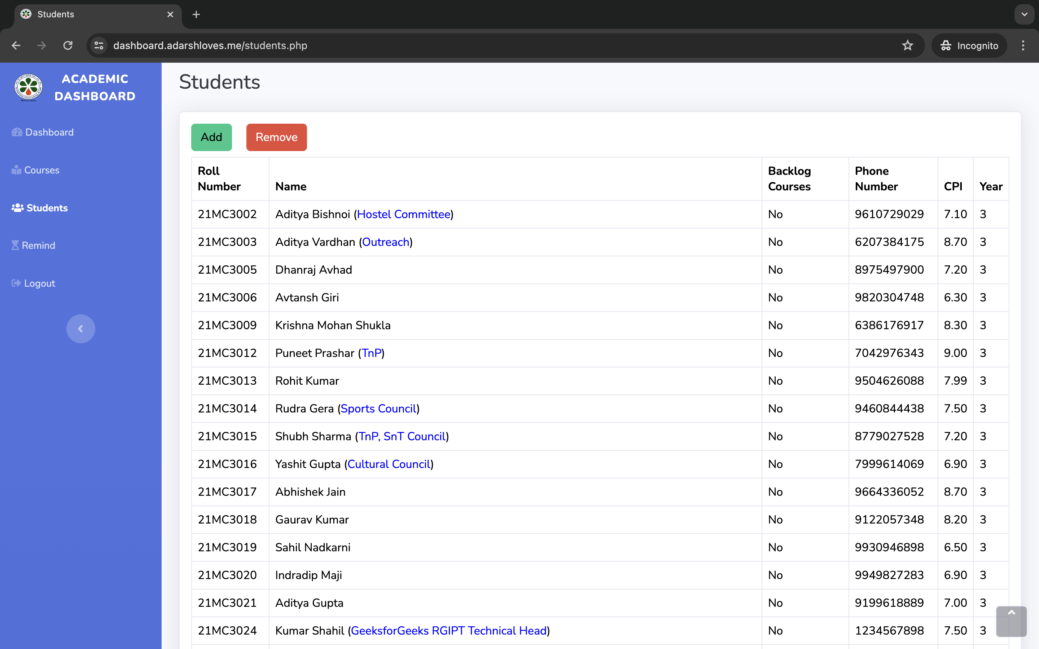
Students

Slide 7
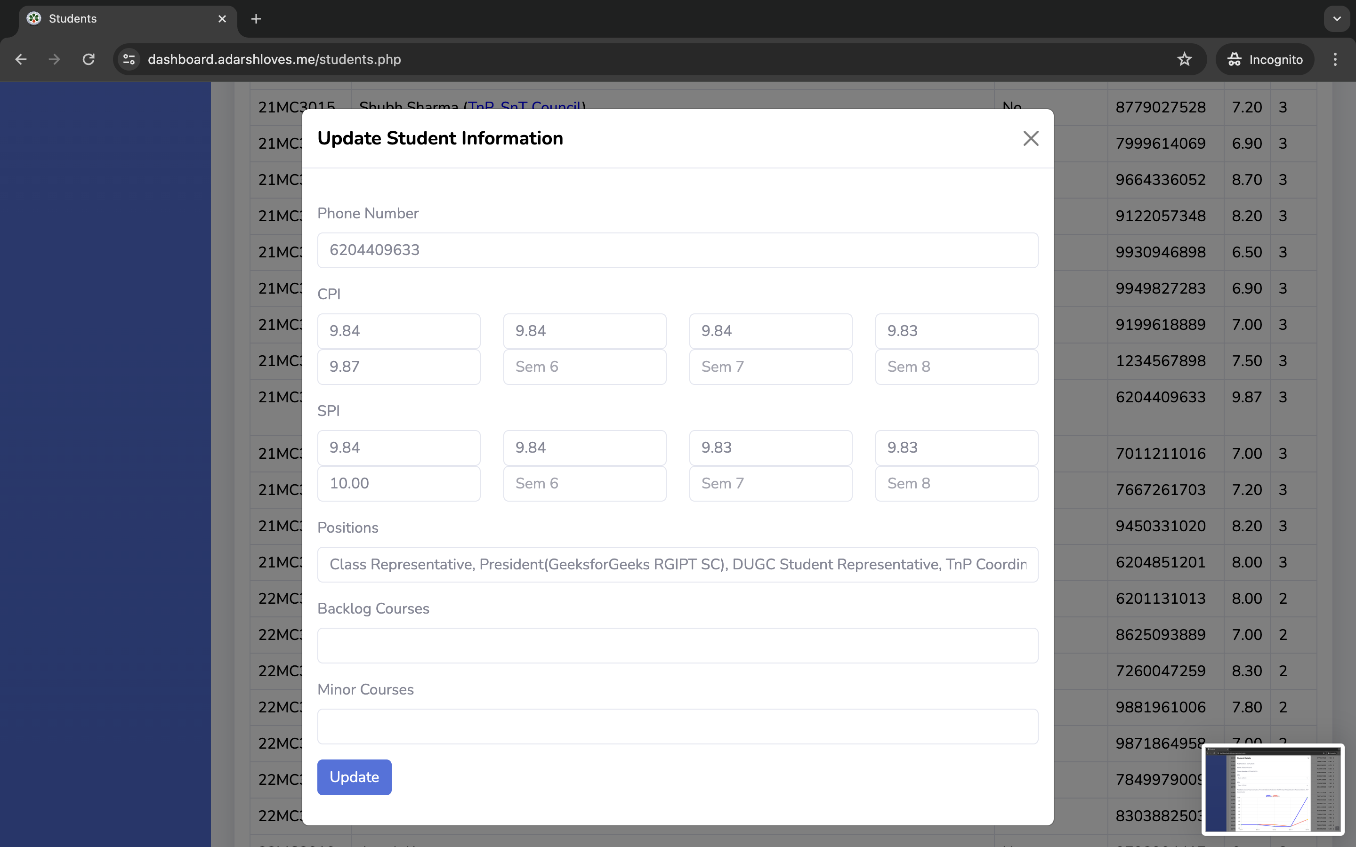
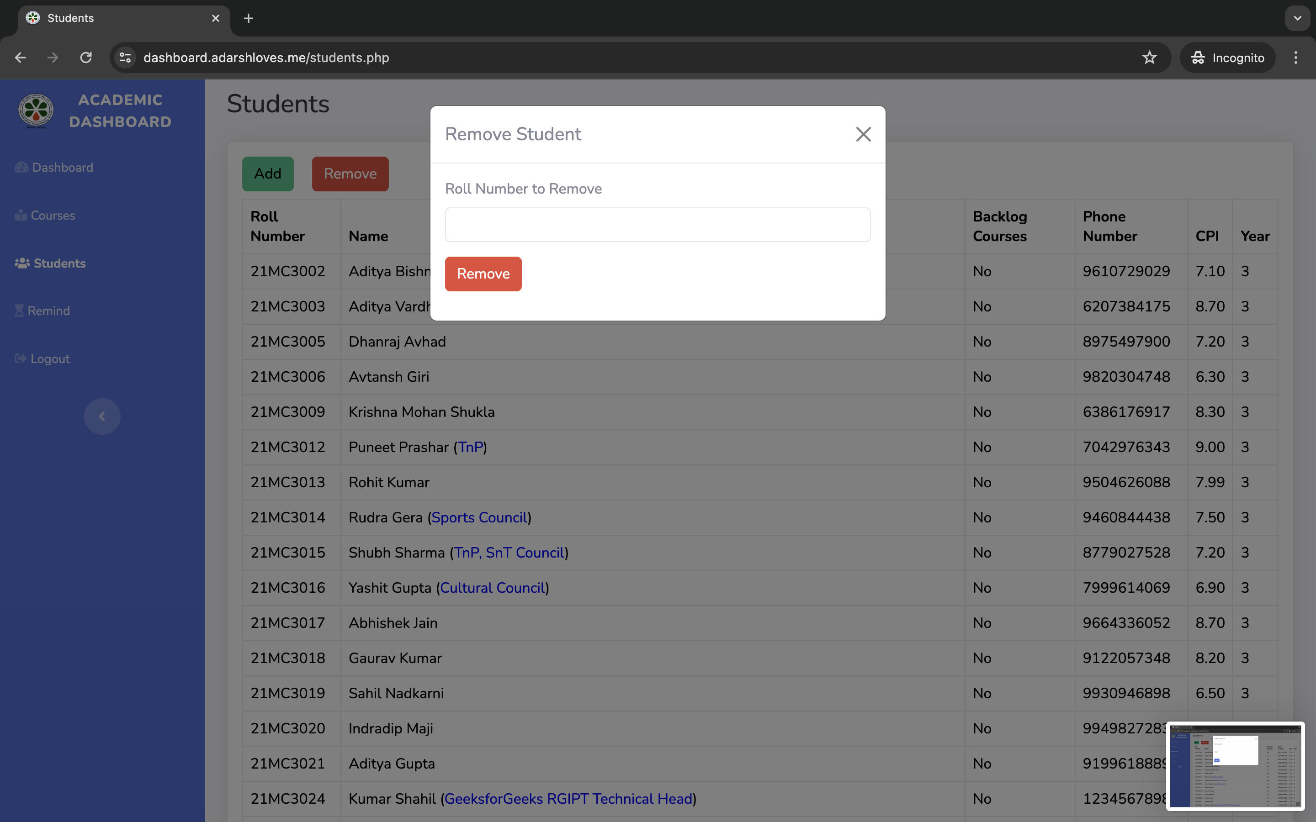
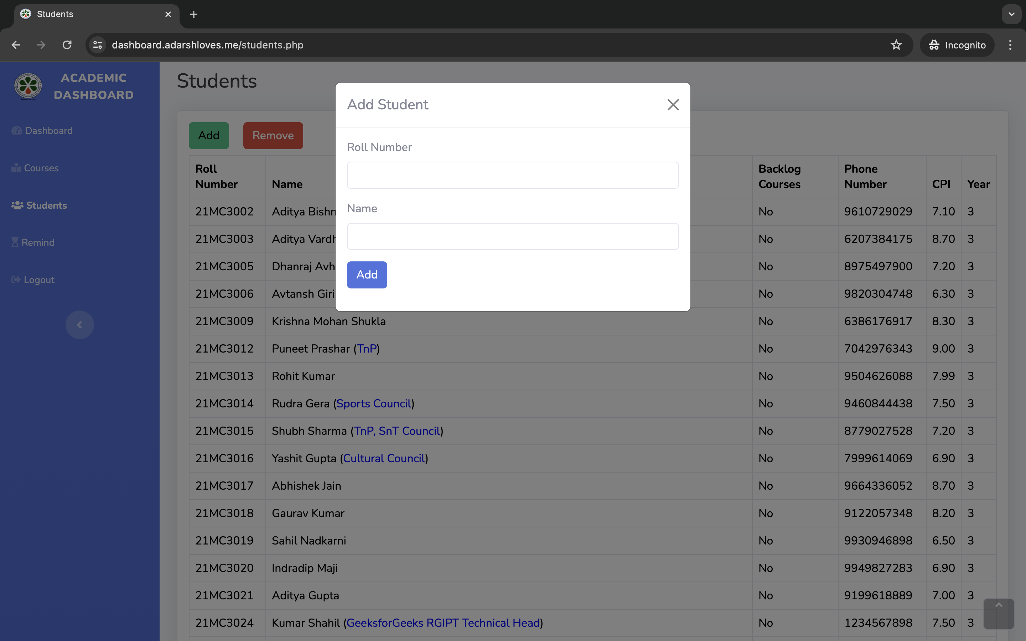
Students Update

Slide 8
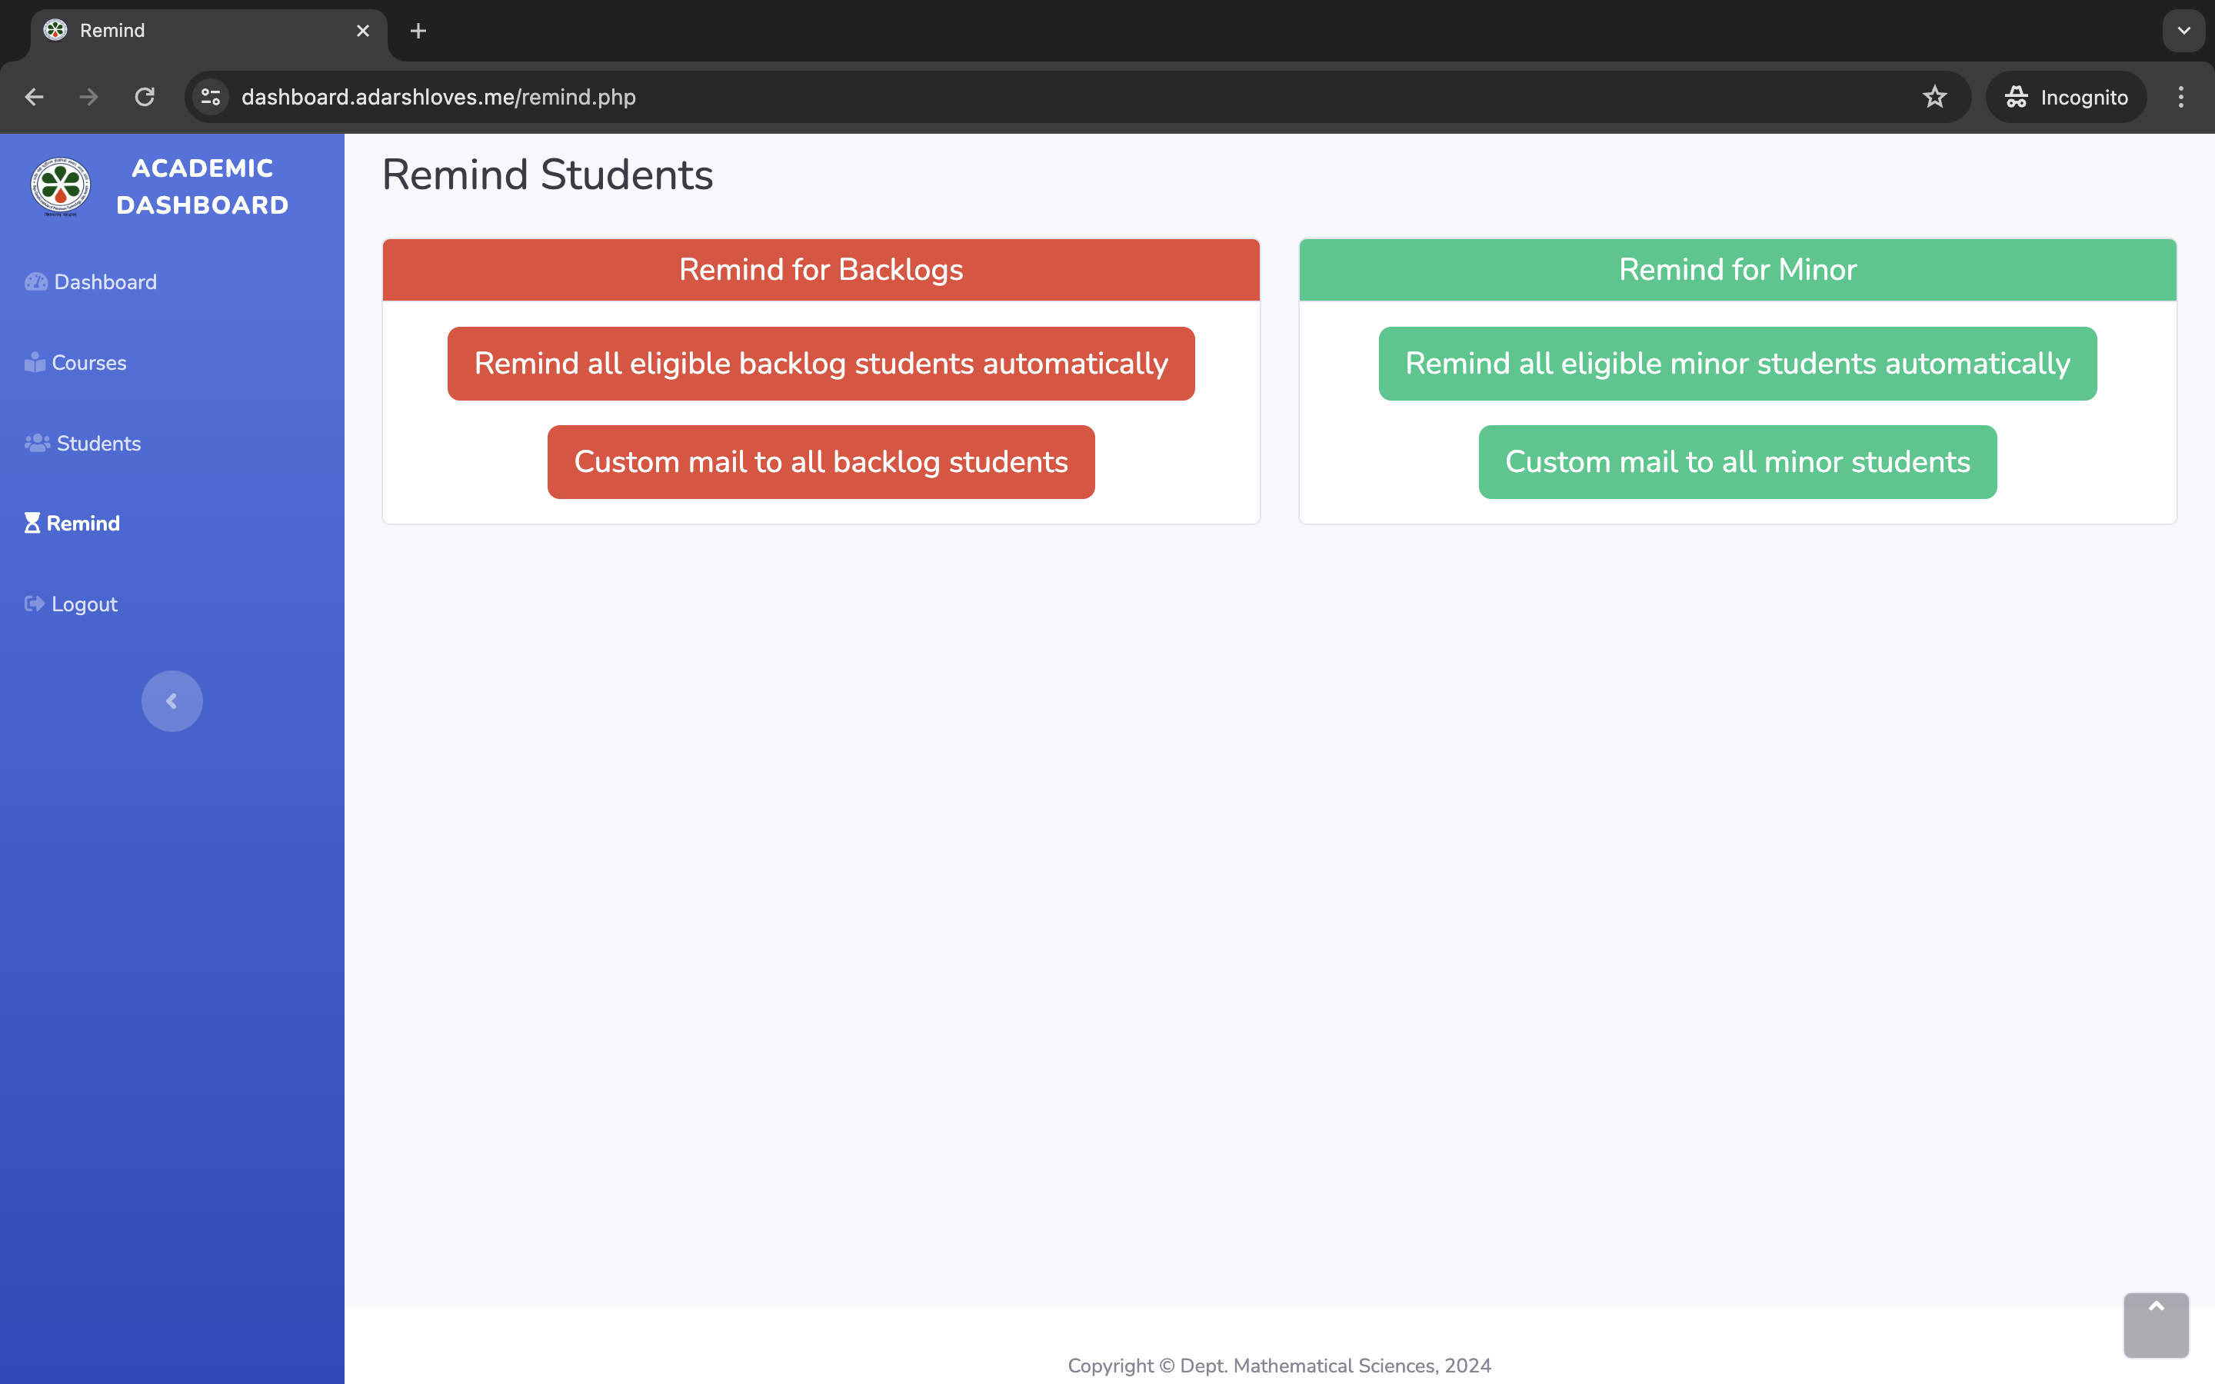
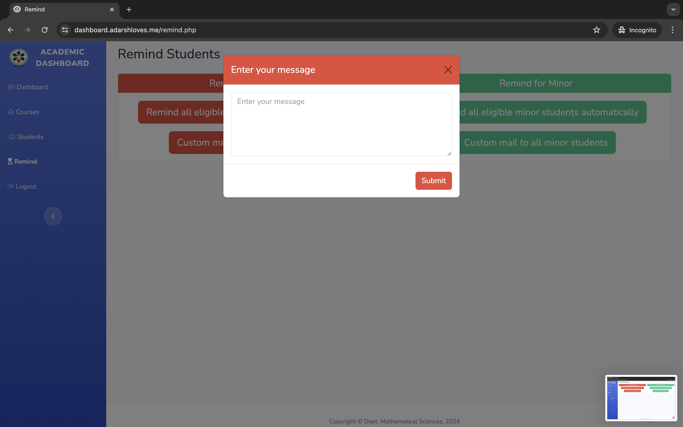
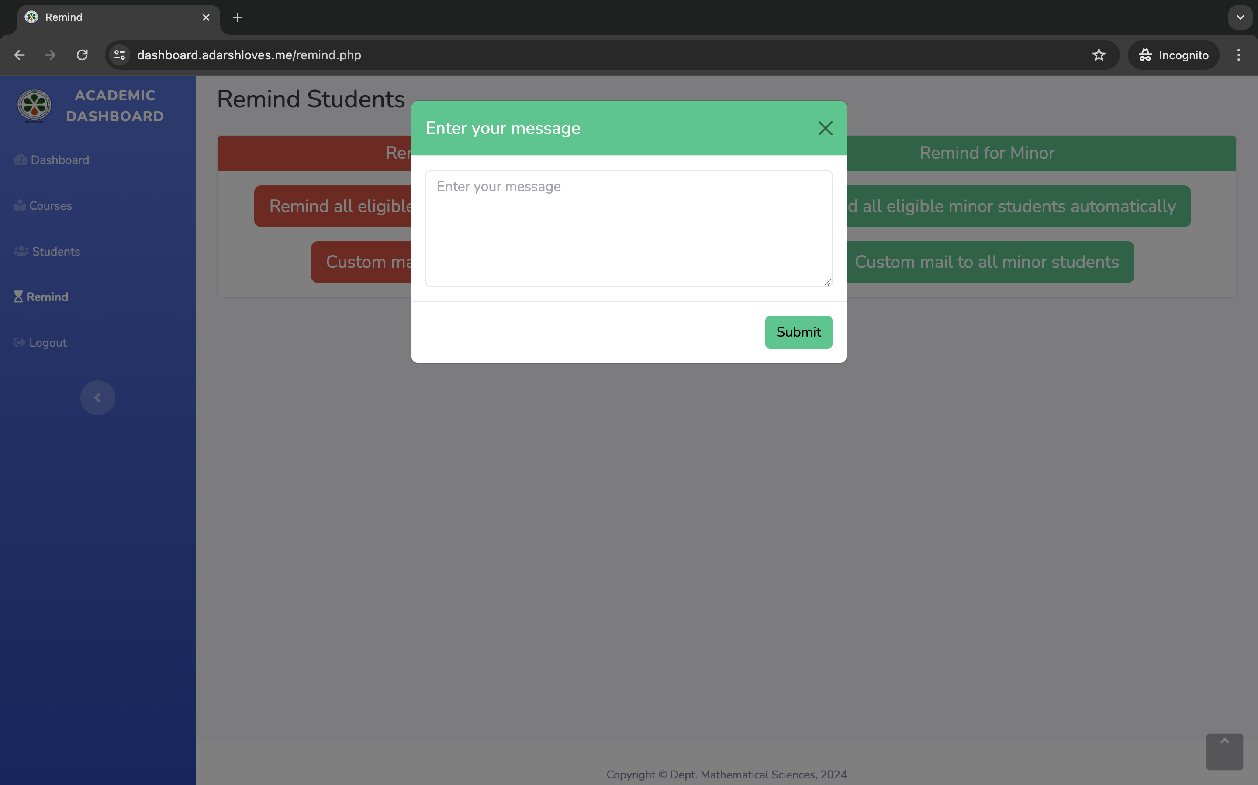
Backlog and Minor Courses Mail

Slide 9
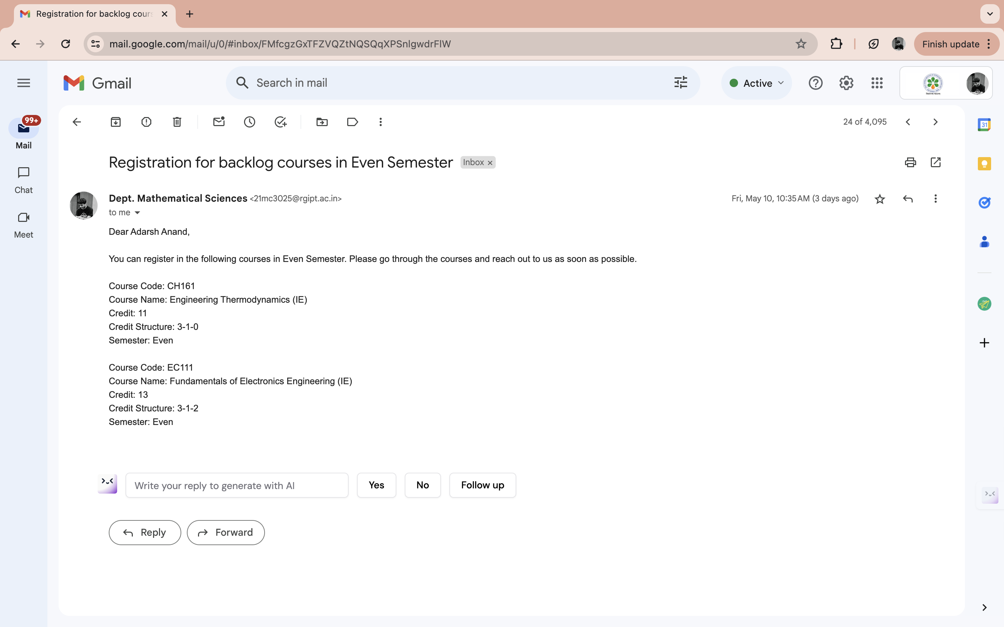
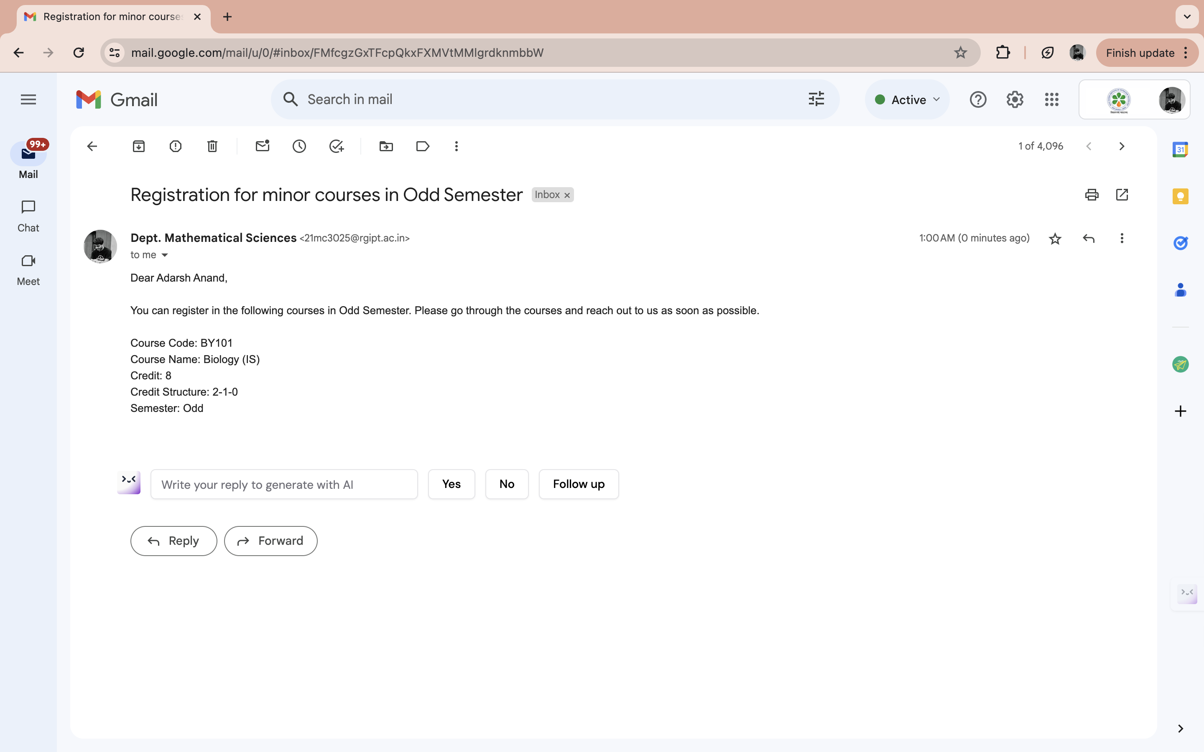
Remind Mail Sample

Slide 10
Results
Increases focus on weak students
Streamlines administrative processes for efficiency
Promotes academic excellence and student success
Integrated features offer a seamless educational experience, promoting student success and institutional effectiveness.
Conclusion
Thank You!

